Slide 1
Ultrasonic imaging in 3-d
Natalia Velasquez

Slide 2
What is ultrasonic Imaging used for
Imaging technique using ultrasound
Used to see internal body structures.
Examples:
Abdominal ultrasound, bone sonometry, breast ultrasound, doppler fetal, doppler ultrasound (visualize blood flow through a blood vessel, organs, or other structures), echocardiogram, ultrasound guided biopsies.

Slide 3
How does it work?
Like the name suggests an ultrasound listens to sound waves that are produced and then bounced back to the source.
Ultrasounds are sounds at frequencies greater than 20 kHz
Typically, ultrasound systems operate in the 2 MHz to 20 MHz frequency range
The device that produces and receives these sound waves is called a transducer

Slide 4
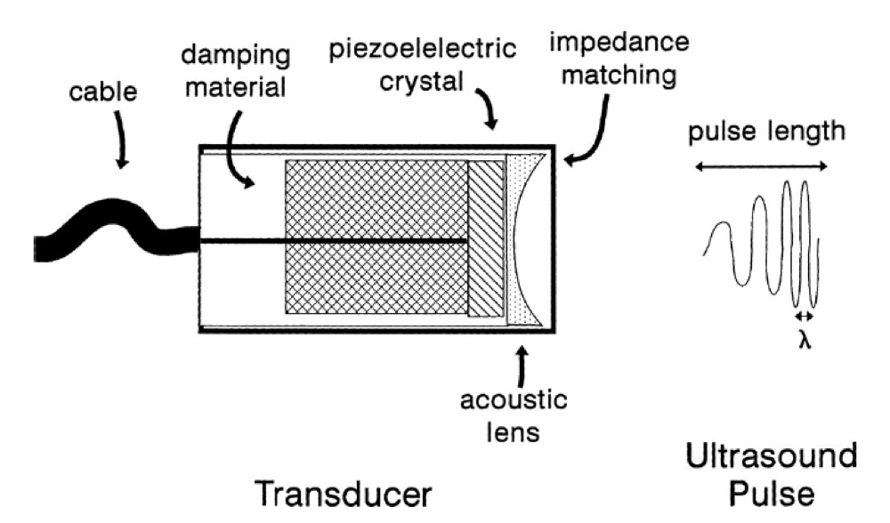
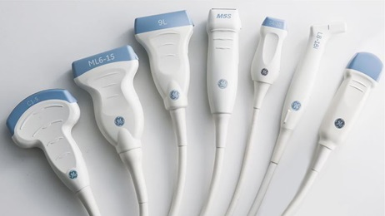
The Transducer
Piezoelectric effect – conversion of electrical energy to mechanical energy
Quartz crystals called piezoelectric crystals
Current is applied to crystals causing them to vibrate at high speed and produce an ultrasound
Sound then bounces back off object and hits the crystals again to then have the reverse effect and convert it back to electrical energy.

Slide 5
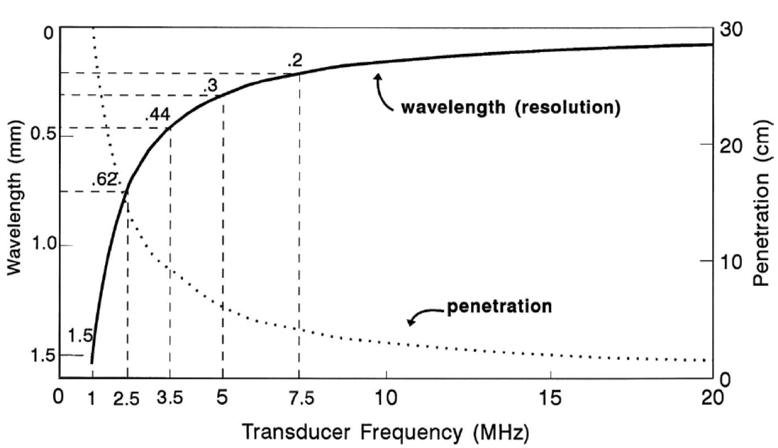

Slide 6
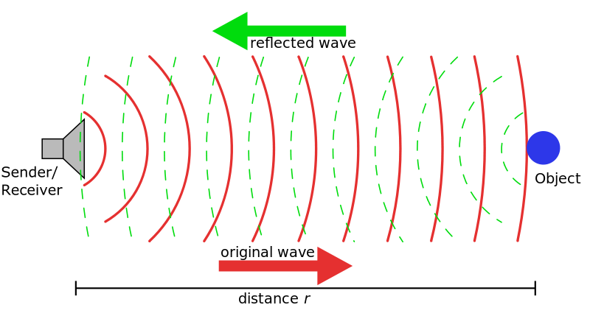
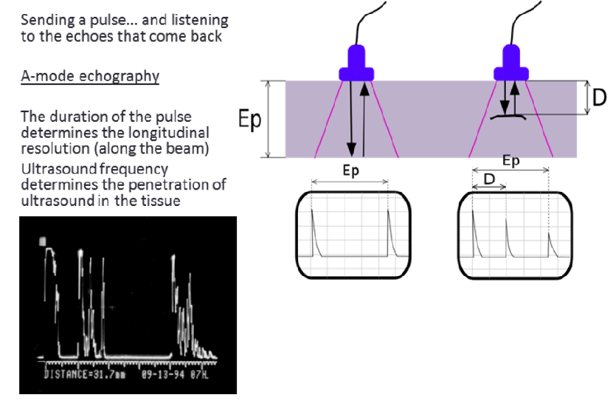

Slide 7
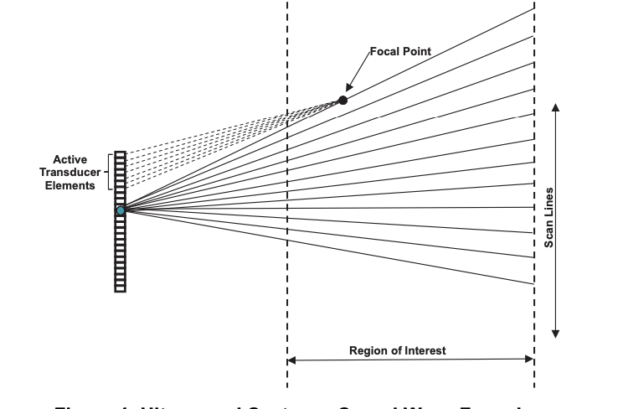
Transducers along a scan line
The reflections of the waves off the structures produced then create the image
Measuring the amplitude of the sound signal and the time of each echo’s return
The transducers focus along a scan line.
The waves reflect off any object they encounter
Then new waves are transmitted along the scan line
Every point is measured along the region desired
and added to construct the image.

Slide 8
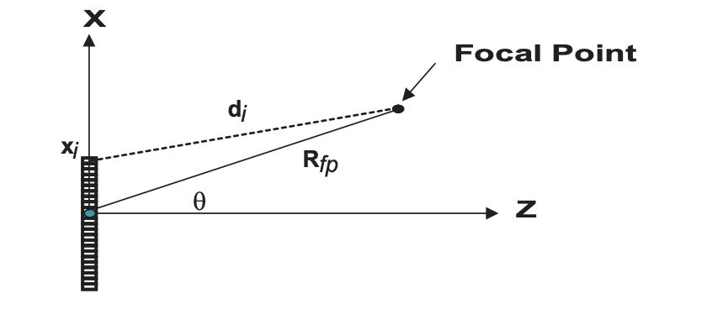
Beamforming
The process of steering and focusing the sound beam

Slide 9
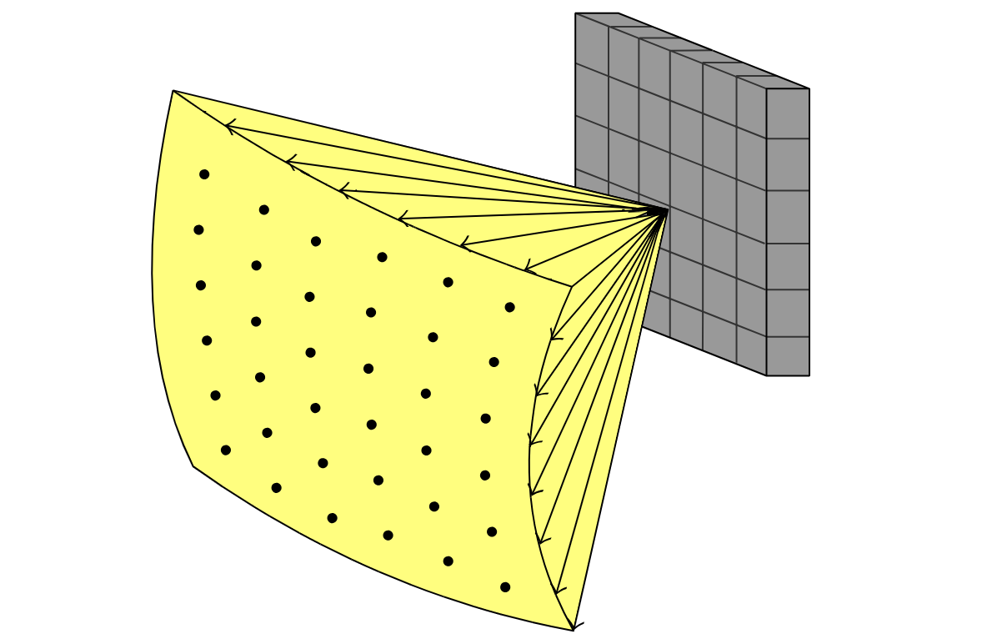

Slide 10
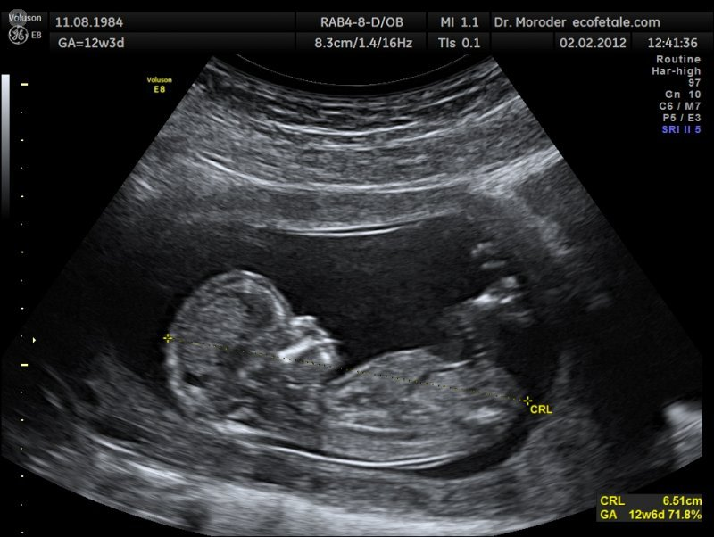
Philips Medical/Ultrasound & Monitoring Systems © Philips]
https://www.topdoctors.es/en/articulos-medicos/diferencias-entre-la-ecografia-2d-3d-y-4d

Slide 11
2D imaging vs. 3D imaging
2D images are flat and mostly outlines images.
Lack of depth and orientation limits the diagnostic accuracy and relies heavily on knowledge and ability of doctors to mentally decipher the image
3D images allow for three dimensional analysis
The same sound waves are used from 2D scanning but they are narrow small pulses that determine the depth of the object in question by looking at the time it takes to get back

Slide 12
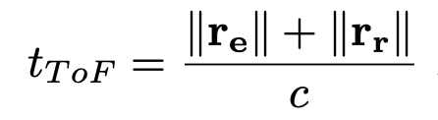
Time of flight
The time of flight is given by the shortest distance from the source to the point and back to the receiving element, divided by the speed of sound.

Slide 13
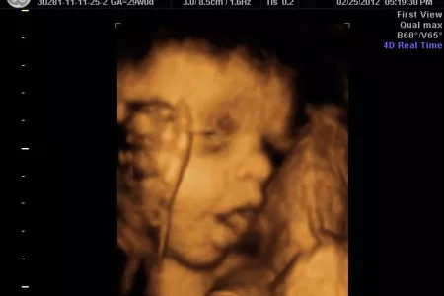

Slide 14
Works cited
Signal Processing Overview of Ultrasound Systems for Medical Imaging, Nov 2008, Murtaza Ali, Dave Magee and Udayan Dasgupta
Image Processing in Medical Ultrasound, 2011, Hemmsen, Martin Christian; Jensen; Jorgen Arendt; Kortbaek, Jacob; Martin, Bo
3D Ultrasound imaging performance of row-column addressed 2D array transducer; a simulation study, 2013, Ramussen, Morten Fischer; Jensen, Jorgen Arendt

