Slide 1
EE359 – Lecture 11 Outline
Doppler and ISI Performance Effects
Introduction to Diversity
Combining Techniques
Selection Combining
Maximal Ratio Combining
MGF Approach to MRC Performance

Slide 2
Review of Last Lecture
Average P_{s} (P_{b}):
MGF approach for average P_{s}
  Average P_{s} becomes a Laplace transform
Combined average and outage P_{s}
P_{s}(γ_{s})
P_{s}(γ_{s})
P_{starget}
P_{s}(γ_{s})

Slide 3
Doppler Effects
High doppler causes channel phase to decorrelate between symbols
Leads to an irreducible error floor for differential modulation
  Increasing power does not reduce error
Error floor depends on B_{d}T_{s}

Slide 4
ISI Effects
Delay spread exceeding a symbol time causes ISI (self interference).
ISI leads to irreducible error floor
  Increasing signal power increases ISI power
ISI requires that T_{s}>>T_{m} (R_{s}<<B_{c})
1
2
3
4
5
0
T_{s}
T_{m}

Slide 5
Introduction to Diversity
Basic Idea
  Send same bits over independent fading paths
    Independent fading paths obtained by time, space, frequency, or polarization diversity
  Combine paths to mitigate fading effects
T_{b}
t
Multiple paths unlikely to fade simultaneously

Slide 6
Combining Techniques
Selection Combining
  Fading path with highest gain used
Maximal Ratio Combining
  All paths cophased and summed with optimal weighting to maximize combiner output SNR
Equal Gain Combining
  All paths cophased and summed with equal weighting
Array/Diversity gain
  Array gain is from noise averaging (AWGN and fading)
  Diversity gain is change in BER slope (fading)

Slide 7
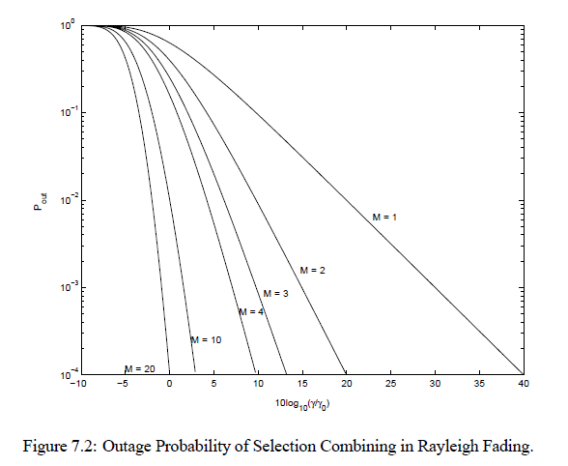
Selection Combining Analysis and Performance
Selection Combining (SC)
  Combiner SNR is the maximum of the branch SNRs.
  CDF easy to obtain, pdf found by differentiating.
  Diminishing returns with number of antennas.
  Can get up to about 20 dB of gain.
Outage
Probability

Slide 8
MRC and its Performance
With MRC, γ_{Σ}=Σγ_{i} for branch SNRs γ_{i}
  Optimal technique to maximize output SNR
  Yields 20-40 dB performance gains
  Distribution of γ_{Σ} hard to obtain
Standard average BER calculation
  Hard to obtain in closed form
  Integral often diverges
MGF Approach

Slide 9
Main Points
Doppler spread only impacts differential modulation causing an irreducible error floor at low data rates
Delay spread causes irreducible error floor or imposes rate limits
Need to combat flat and frequency-selective fading
Diversity overcomes the effects of fading by combining fading paths
Diversity typically entails some penalty in terms of rate, bandwidth, complexity, or size.
Techniques trade complexity for performance.
  MRC yields 20-40 dB gain, SC around 20 dB.
Analysis of MRC simplified using MGF approach

