Slide 1
EE359 – Lecture 12 Outline
Combining Techniques
Maximal Ratio Combining
MGF Approach to MRC Performance
EGC
Transmit Diversity
Not covered in lecture or on exam
Midterm Review

Slide 2
Review of Last Lecture
Performance in ISI and Doppler
Introduction to Diversity
Send same bits over independent fading paths
Time, space, frequency, or polarization diversity
Combine paths to mitigate fading effects
Performance metrics: Array and Diversity gain
Structure of a Diversity Combiner
t

Slide 3
Combining Techniques
Selection Combining
Fading path with highest gain used
Maximal Ratio Combining
All paths cophased and summed with optimal weighting to maximize combiner output SNR
Equal Gain Combining
All paths cophased and summed with equal weighting
Array/Diversity gain
Array gain is from noise averaging (AWGN and fading)
Diversity gain is change in BER slope (fading)

Slide 4
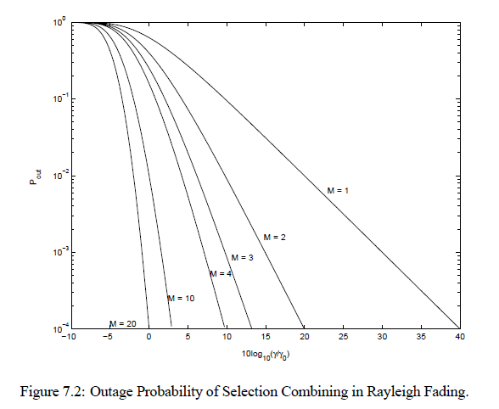
Selection Combining Analysis and Performance
Selection Combining (SC)
Combiner SNR is the maximum of the branch SNRs.
CDF easy to obtain, pdf found by differentiating.
Diminishing returns with number of antennas.
Can get up to about 20 dB of gain.
Outage
Probability

Slide 5
MRC and its Performance
With MRC, γ_{Σ}=Σγ_{i} for branch SNRs γ_{i}
Optimal technique to maximize output SNR
Yields 20-40 dB performance gains
Distribution of γ_{Σ} hard to obtain
Standard average BER calculation
Hard to obtain in closed form
Integral often diverges
MGF Approach

Slide 6
EGC and Transmit Diversity
EGQ simpler than MRC
Paths co-phased, combined with equal gain
Harder to analyze
Performance about 1 dB worse than MRC
Transmit diversity
With channel knowledge, similar to receiver diversity, same array/diversity gain
Without channel knowledge, can obtain diversity gain through Alamouti scheme: works over 2 consecutive symbols

Slide 7
Main Points
MRC optimally combines fading paths to maximize combiner SNR
MRC vs SC trade off complexity for performance.
MRC yields 20-40 dB gain, SC around 20 dB.
Analysis of MRC simplified using MGF approach
EGC easier to implement than MRC: hard to analyze: Performance about 1 dB worse than MRC
Transmit diversity can obtain diversity gain even without channel information at transmitter.

Slide 8
Midterm Review
Overview of Wireless Systems
Signal Propagation and Channel Models
Modulation and Performance Metrics
Impact of Channel on Performance
Fundamental Capacity Limits
Diversity Techniques
Main Points

