Slide 1
EE359 – Lecture 15 Outline
Introduction to MIMO Communications
MIMO Channel Decomposition
MIMO Channel Capacity
MIMO Beamforming
Diversity/Multiplexing Tradeoffs

Slide 2
Review of Last Lecture
  Adaptive Mod. with Restriction: M(γ) ∈M_{D}
  Map γ to straight line M(γ)=γ/γ*_{k}
  Pick region boundaries γ_{i} such that M(γ_{i})∈M_{D}
  Use inverse waterfilling power control per region
Practical constraints in adaptive modulation
  Constellation update rate
  Estimation error and delay
    Lead to irreducible error floor that depends on estimation error, channel, and their joint distribution
For typical Dopplers,
constant for 10s to
100s of symbol times

Slide 3
Multiple Input Multiple
Output (MIMO)Systems
MIMO systems have multiple (r) transmit and receiver antennas
With perfect channel estimates at TX and RX, decomposes into r independent channels
  R_{H}-fold capacity increase over SISO system
  Demodulation complexity reduction
  Can also use antennas for diversity (beamforming)
  Leads to capacity versus diversity tradeoff in MIMO

Slide 4
MIMO Decomposition
Decompose channel through transmit precoding (x=Vx) and receiver shaping (y=U^{H}y)
Leads to R_{H}≤min(M_{t},M_{r}) independent channels with gain σ_{i} (i^{th} singular value of H) and AWGN
Independent channels lead to simple capacity analysis and modulation/demodulation design
~
~
~
~
~
y=Hx+n
y=Σ x+n
H=UΣV^{H}
~
~
~
y_{i}=σ_{ι}x+n_{i}

Slide 5
Capacity of MIMO Systems
Depends on what is known at TX and RX and if channel is static or fading
For static channel with perfect CSI at TX and RX, power water-filling over space is optimal:
  In fading waterfill over space (based on short-term power constraint) or space-time (long-term constraint)
Without transmitter channel knowledge, capacity metric is based on an outage probability
  P_{out} is the probability that the channel capacity given the channel realization is below the transmission rate.

Slide 6
Beamforming
Scalar codes with transmit precoding
y=u^{H}Hvx+u^{H}n
Transforms system into a SISO system with diversity.
  Array and diversity gain
  Greatly simplifies encoding and decoding.
  Channel indicates the best direction to beamform
  Need “sufficient” knowledge for optimality of beamforming

Slide 7
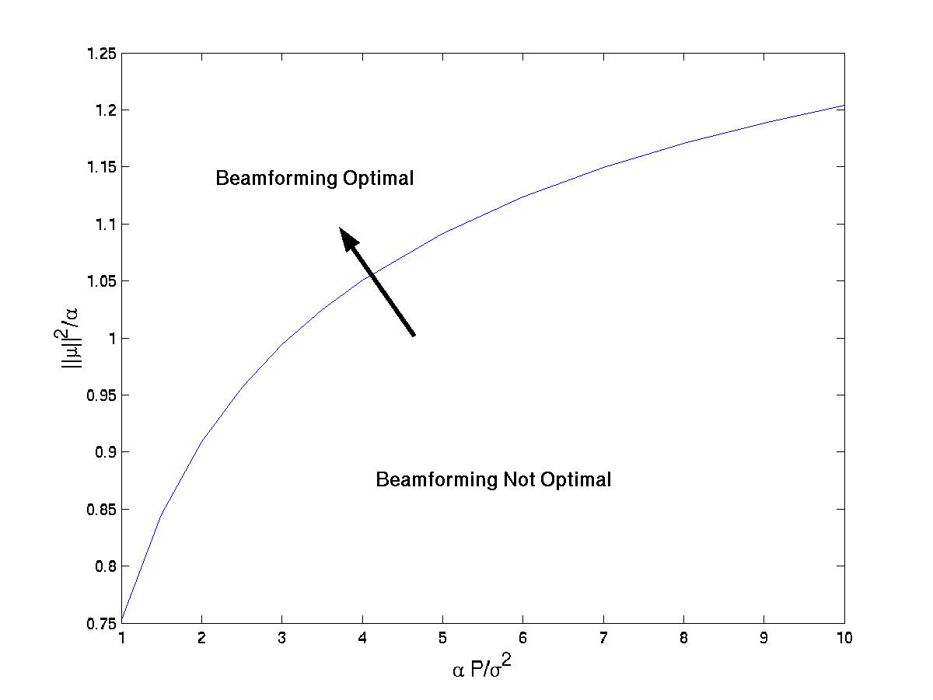
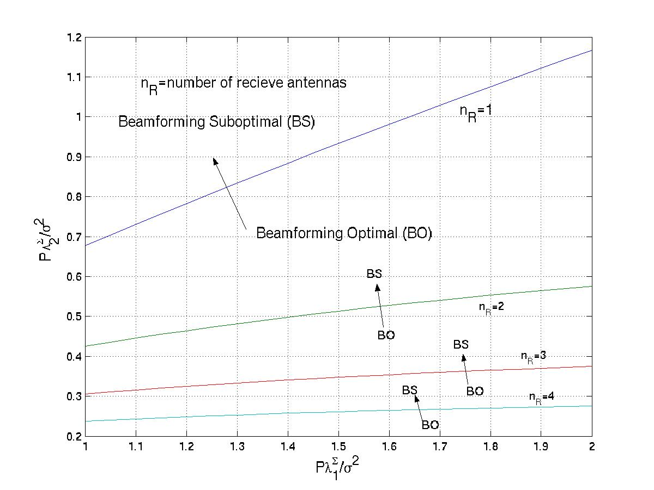
Optimality of Beamforming
Mean Information
Covariance Information

Slide 8
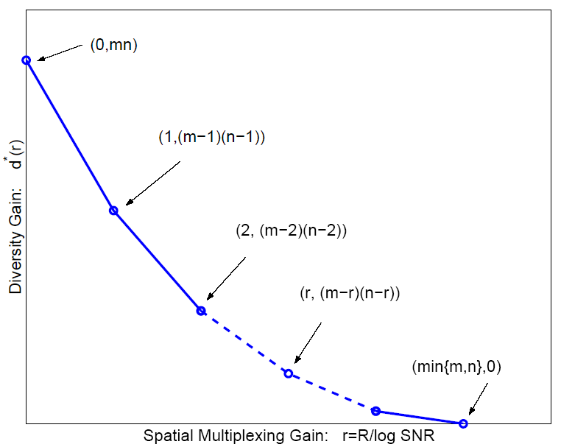
Diversity vs. Multiplexing
Use antennas for multiplexing or diversity
Diversity/Multiplexing tradeoffs (Zheng/Tse)
Error Prone
Low P_{e}

Slide 9
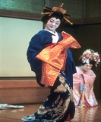



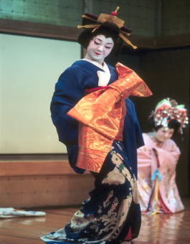
How should antennas be used?
Use antennas for multiplexing:
Use antennas for diversity
High-Rate
Quantizer
ST Code
High Rate
Decoder
Error Prone
Low-Rate
Quantizer
ST Code
High
Diversity
Decoder
Low P_{e}
Depends on end-to-end metric: Solve by optimizing app. metric

Slide 10
Main Points
MIMO systems exploit multiple antennas at both TX and RX for capacity and/or diversity gain
With TX and RX channel knowledge, channel decomposes into independent channels
  Linear capacity increase with number of TX/RX antennas
  Without TX CSI, capacity vs. outage is the capacity metric
MIMO introduces diversity/multiplexing tradeoff
  Optimal use of antennas depends on application

