Slide 1
EE359 – Lecture 7 Outline
Multipath Intensity Profile
Doppler Power Spectrum
Shannon Capacity
Capacity of Flat-Fading Channels
Fading Statistics Known
Fading Known at RX

Slide 2
Review of Last Lecture
Signal envelope distributions:
CLT approx. → Rayleigh distribution (power exponential)
When LOS present, Ricean distribution used
Measurements support Nakagami distribution
Average Fade Duration:
Rayleigh fading AFD
Wideband Channels
Individual multipath components resolvable
True when time difference between multipath components exceeds signal bandwidth
t₁
t₂
t₃
R

Slide 3
Characterizing Wideband Channels
Wideband channels introduce time-distortion (τ) and time-variation (Doppler, ρ)
Wideband channels c(τ,t) characterized by scattering function from A_{c}(τ₁,τ₂,Δt)=A_{c}(τ,Δt)
τ
τ
Narrowband
Wideband
s(τ,ρ)=F_{Δt}[A_{c}(τ,Δt)]
ρ
τ
Characterizes delay spread & Doppler

Slide 4
Multipath Intensity Profile
A_{c}(τ)
T_{M}
Defined as A_{c}(τ,Δt=0)= A_{c}(τ)
Determines average (T_{M} ) and rms (σ_{τ}) delay spread
Approximate max delay of significant m.p.
Coherence bandwidth B_{c}=1/T_{M}
Maximum frequency over which A_{c}(Δf)=F[A_{c}(τ)]>0
A_{c}(Δf)=0 implies signals separated in frequency by Δf will be uncorrelated after passing through channel
τ
A_{c}(f)
τ
0
Bc
f

Slide 5
Doppler Power Spectrum
S_{c}(ρ)
ρ
B_{d}
S_{c}(ρ)=F[A_{c}(τ=0,Δt)]= F[A_{c}(Δt)]
Doppler spread B_{d} is maximum doppler for which S_{c} (ρ)=>0.
Coherence time T_{c}=1/B_{d}
Maximum time over which A_{c}(Δt)>0
A_{c}(Δt)=0 implies signals separated in time by Δt will be uncorrelated after passing through channel

Slide 6
Shannon Capacity
Defined as the maximum MI of channel
Maximum error-free data rate a channel can support.
Theoretical limit (not achievable)
Channel characteristic
Not dependent on design techniques

Slide 7
Capacity of Flat-Fading Channels
Capacity defines theoretical rate limit
Maximum error free rate a channel can support
Depends on what is known about channel
Fading Statistics Known
Hard to find capacity
Fading Known at Receiver Only

Slide 8
Capacity with Fading Known at Transmitter and Receiver
For fixed transmit power, same as with only receiver knowledge of fading
Transmit power P(γ) can also be adapted
Leads to optimization problem

Slide 9
Optimal Adaptive Scheme
Waterfilling
Power Adaptation
Capacity
1
γ
γ₀
γ

Slide 10
Channel Inversion
Fading inverted to maintain constant SNR
Simplifies design (fixed rate)
Greatly reduces capacity
Capacity is zero in Rayleigh fading
Truncated inversion
Invert channel above cutoff fade depth
Constant SNR (fixed rate) above cutoff
Cutoff greatly increases capacity
Close to optimal

Slide 11
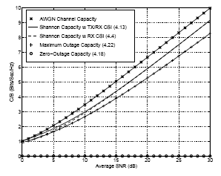
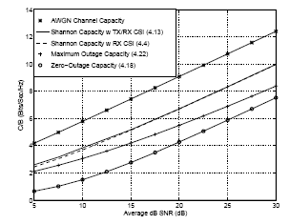
Capacity in Flat-Fading
Rayleigh
Log-Normal

Slide 12
Main Points
Delay spread defines maximum delay of significant multipath components. Inverse is coherence BW
Doppler spread defines maximum nonzero doppler, its inverse is coherence time
Fundamental channel capacity defines maximum data rate that can be supported on a channel
Capacity in fading depends what is known at TX & RX
Capacity with RX CSI is average of AWGN capacity
Capacity with TX/RX knowledge: variable-rate variable-power transmission (water filling) optimal
Almost same capacity as with RX knowledge only
Channel inversion practical, but should truncate

