Slide 1
EE359 – Lecture 8 Outline
Capacity of Fading channels
  Fading Known at TX and RX
  Optimal Rate and Power Adaptation
  Channel Inversion with Fixed Rate
Capacity of Freq. Selective Fading Channels
Linear Modulation Review

Slide 2
Review of Last Lecture
s(τ,ρ)=F_{Δt}[A_{c}(τ,Δt)]
Scattering Function:
  Used to characterize c(τ,t) statistically
Multipath Intensity Profile
  Determines average (T_{M} ) and rms (σ_{τ}) delay spread
  Coherence bandwidth B_{c}=1/T_{M}
Doppler Power Spectrum: S_{c}(ρ)= F[A_{c}(Δt)]
  Power of multipath at given Doppler
ρ
τ
A_{c}(f)
0
f
τ
Bc

Slide 3
Review of Last Lecture (Ctd)
Channel Capacity
  Maximum data rate that can be transmitted over a channel with arbitrarily small error
Capacity of AWGN Channel: Blog₂[1+γ] bps
  γ=P_{r}/N is the receiver SNR
Capacity of Flat-Fading Channels
  Nothing known: capacity typically zero
  Fading Statistics Known (few results)
  Fading Known at RX (average capacity)

Slide 4
Capacity with Fading Known at
Transmitter and Receiver
For fixed transmit power, same as with only receiver knowledge of fading
Transmit power P(γ) can also be adapted
Leads to optimization problem

Slide 5
Optimal Adaptive Scheme
Waterfilling
Power Adaptation
Capacity
1
γ
γ₀
γ

Slide 6
Channel Inversion
Fading inverted to maintain constant SNR
Simplifies design (fixed rate)
Greatly reduces capacity
  Capacity is zero in Rayleigh fading
Truncated inversion
  Invert channel above cutoff fade depth
  Constant SNR (fixed rate) above cutoff
  Cutoff greatly increases capacity
    Close to optimal

Slide 7
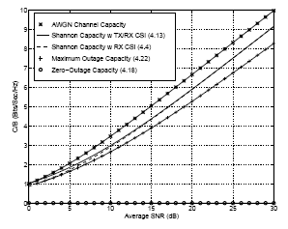
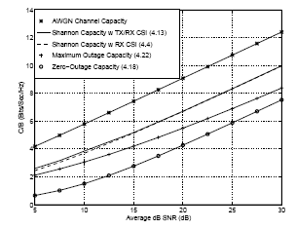
Capacity in Flat-Fading
Rayleigh
Log-Normal

Slide 8
Frequency Selective
Fading Channels
For time-invariant channels, capacity achieved by water-filling in frequency
Capacity of time-varying channel unknown
Approximate by dividing into subbands
  Each subband has width B_{c} (like MCM).
  Independent fading in each subband
  Capacity is the sum of subband capacities
1/|H(f)|²
P
B_{c}
f

Slide 9
Passband Modulation Tradeoffs
Want high rates, high spectral efficiency, high power efficiency, robust to channel, cheap.
Amplitude/Phase Modulation (MPSK,MQAM)
  Information encoded in amplitude/phase
  More spectrally efficient than frequency modulation
  Issues: differential encoding, pulse shaping, bit mapping.
Frequency Modulation (FSK)
  Information encoded in frequency
  Continuous phase (CPFSK) special case of FM
  Bandwidth determined by Carson’s rule (pulse shaping)
  More robust to channel and amplifier nonlinearities
Our focus

Slide 10
Amplitude/Phase Modulation
Signal over ith symbol period:
Pulse shape g(t) typically Nyquist
Signal constellation defined by (s_{i1},s_{i2}) pairs
Can be differentially encoded
M values for (s_{i1},s_{i2})⇒log₂ M bits per symbol

Slide 11
Main Points
Fundamental capacity of flat-fading channels depends on what is known at TX and RX.
  Capacity with TX/RX knowledge: variable-rate variable-power transmission (water filling) optimal
  Almost same capacity as with RX knowledge only
  Channel inversion practical, but should truncate
Capacity of wideband channel obtained by breaking up channel into subbands
  Similar to multicarrier modulation
Linear modulation more spectrally efficient but less robust than nonlinear modulation

