Slide 1
Chapter 1
Communication Systems
Overview
Communication is a battle between signal and noise/distortion

Slide 2
Chapter 1
Summary
Information representation
Communication system block diagrams
Analog versus digital systems
Performance metrics
Data rate limits
Next lecture: signals and signal space (L&D chapter 2)

Slide 3
Information Types
Major classification of data: analog vs. digital
Analog signals
  speech (words are sometimes discrete in time)
  music (closer to a continuous signal)
  temperature readings, barometric pressure, wind speed
  images stored on film
Analog signals can be represented (approximately) using bits
  digitized images (can be compressed using JPEG)
  digitized video (can be compressed to MPEG)
Bits: text, computer data
  Analog signals can be converted into bits by quantizing/digitizing
  The word bit (binary digit) was coined in the late 1940s by John Tukey.
  Today a byte is 8 bits. Originally it depended on the computer-6, 9, or 10 bits were also used.

Slide 4

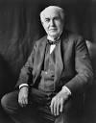
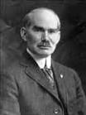

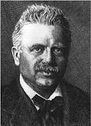


Analog Messages
Early analog communication
  Telephone (1876, Alexander Graham Bell)
  Phonograph (1877, Thomas Alva Edison)
  Film soundtrack (1923, Lee DeForest, Joseph Tykoci´nski-Tykociner)
  Magnetic Recording (1899, Valdemar Poulsen & 1939, Marvin Camras)
Key to early analog communication is the amplifier
(1908, Lee DeForest, triode vacuum tube)
Broadcast radio (AM, FM) is analog – HD radio is digital
Broadcast television (1927, Philo Farnsworth) was analog
until 2009 – now digital

Slide 5
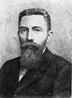

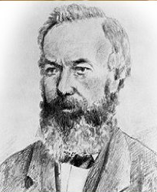
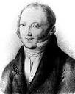
Digital Messages
Early long-distance communication was digital
  semaphores, white flag, smoke signals, drums, bugle calls,
  telegraph (1844, Samuel Morse)
  Teletypewriters (stock quotations)
  Emile Baudot (1874) created 5-unit code for alphabet. Today baud is a unit
  meaning one symbol per second.
Working teleprinters were in service by 1924 at 65 words per minute
Fax machines: Group 3 (voice lines) and Group 4 (ISDN)
  In 1990s the accounted for majority of transPacific telephone use. Sadly, fax machines are still in use.
  First fax machine was Alexander Bains 1843 device required conductive ink
  Pantelegraph (Giovanni Caselli, 1865) set up telefax between Paris and Lyon
Ethernet, WiFi, Internet

Slide 6
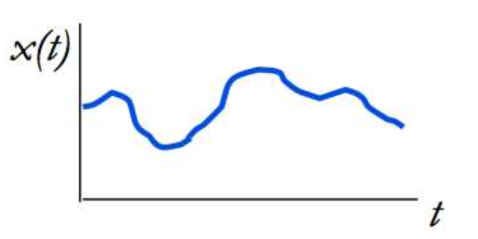
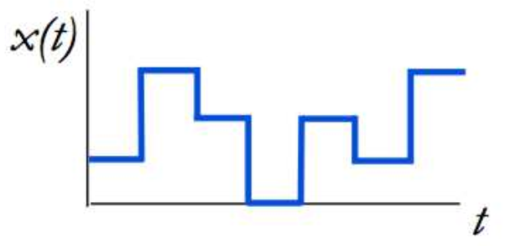
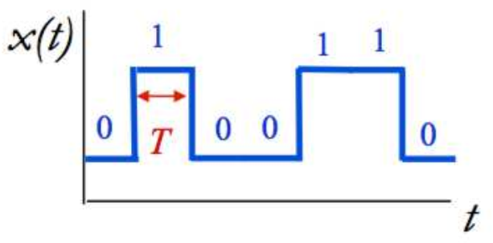
Analog vs. Digital Systems
Analog signals
  Values varies continuously
Digital signals
  Value limited to a finite set
  Digital systems are more robust
Binary signals
  Have 2 possible values
  Used to represent bit values
  Bit time T needed to send 1 bit
  Data rate R = 1/T bits per second

Slide 7
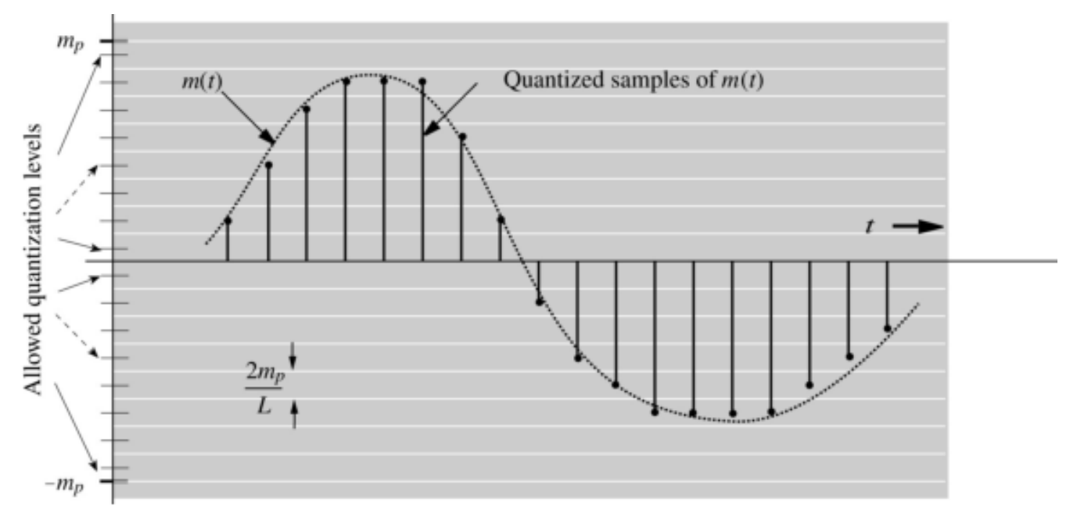

Sampling and Quantization, 1
Quantization spacing is $\frac{2m_{p}}{L}$
sampling interval is T (not shown in figure)

Slide 8
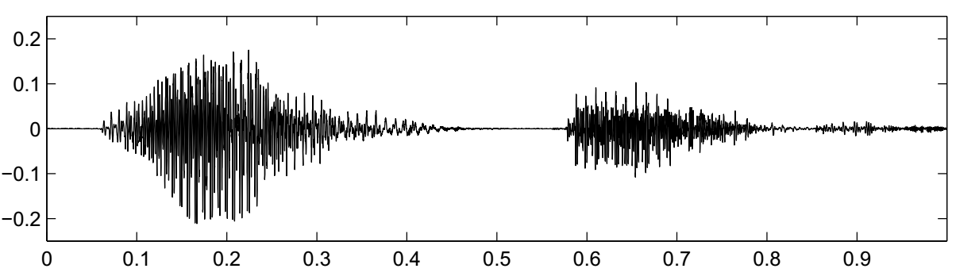
Sampling and Quantization, 2
Usually sample times are uniformly spaced. Higher frequency content requires faster sampling. (Soprano must be sampled twice as fast as a tenor.)
Digital alues can be uniformly spaced, but nonuniform (logarithmic) spacing is often used for voice.

Slide 9
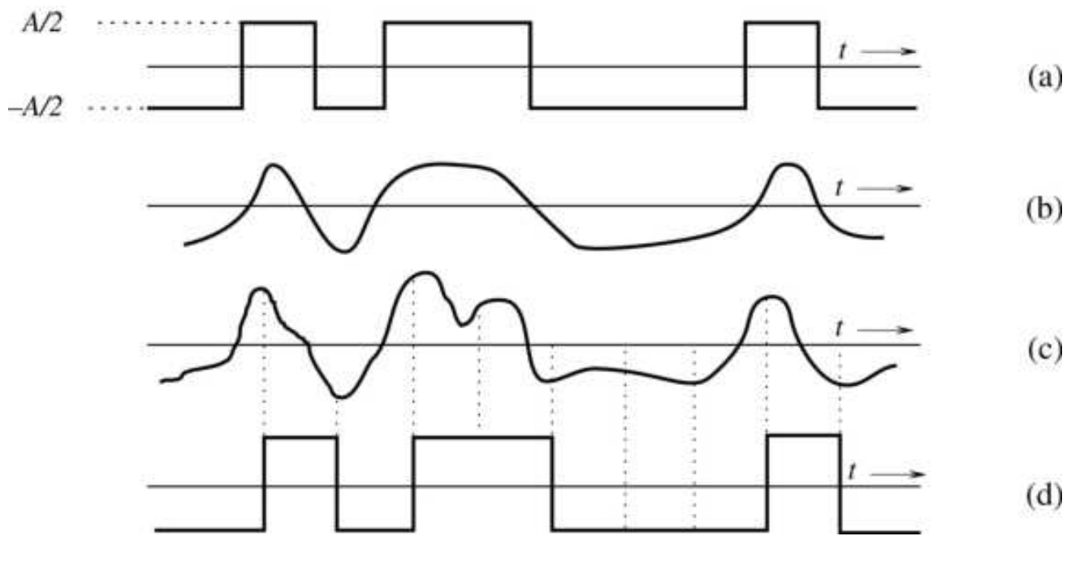
Digital Transmission and Regeneration
Simplest digital communication is binary amplitude-shift keying (ASK)
(a) binary signal input to channel; (b) signal altered by channel;
(c) signal + noise; (d) signal after detection by receiver

Slide 10
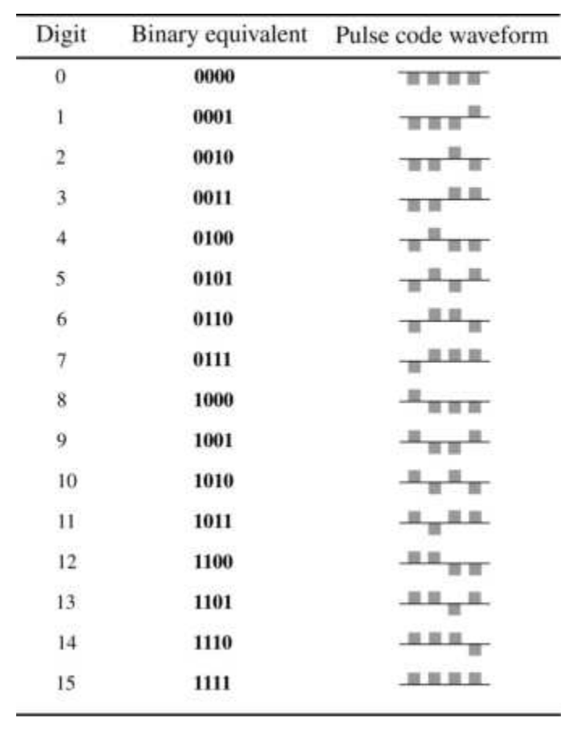
Pulse Code Modulation (PCM)
To communicate sampled values, we send a
sequence of bits that represent the quantized
value.
For 16 quantization levels, 4 bits suffice.
PCM can use binary representation of value.
The PSTN uses companded PCM
(similar to floating point)

Slide 11
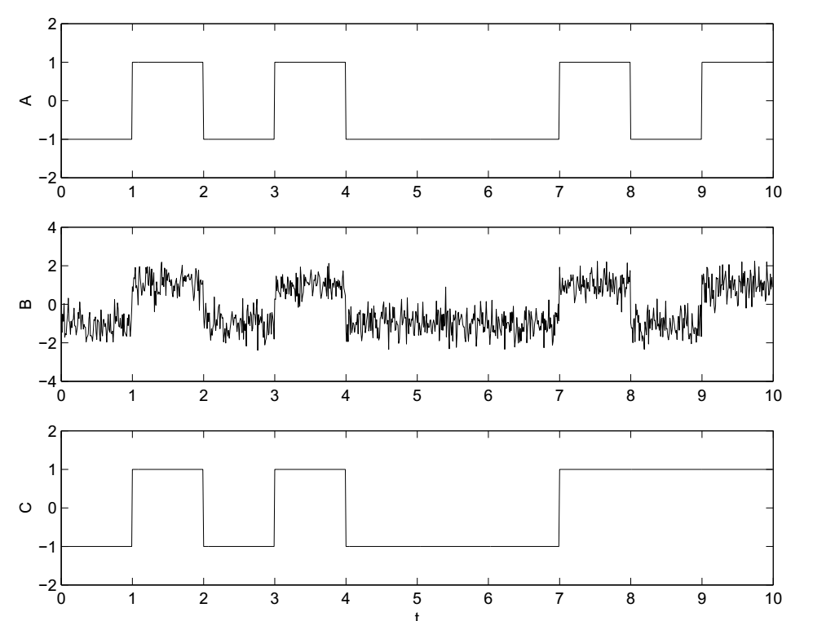
Channel Errors
If there is too much channel distortion
or noise, receiver may make a mistake,
and the regenerated signal will be
incorrect. Channel coding is needed to
detect and correct the message.

Slide 12
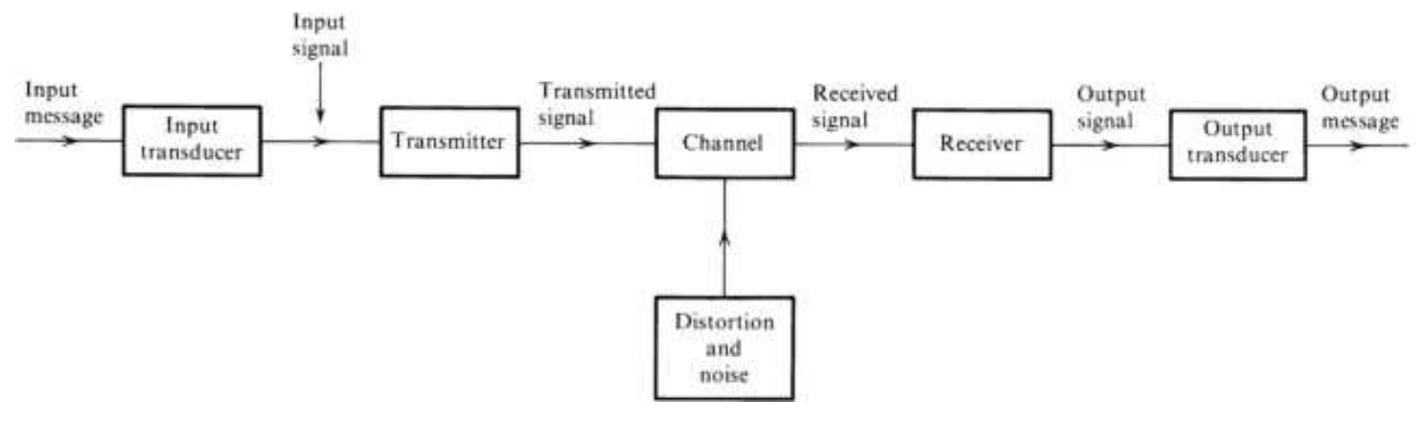
Digital Communication System Block Diagram (Basic)
Source encoder converts message into message signal (bits)
Transmitter converts message signal into format appropriate for channel transmission (analog/digital signal)
Channel conveys signal but may introduce attenuation, distortion, noise, interference
Receiver decodes received signal back to message signal
Source decoder decodes message signal back into original message

Slide 13
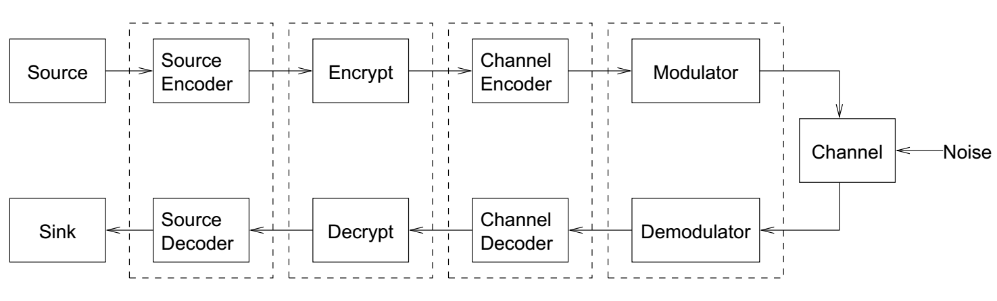
Digital Communication System Block Diagram (Advanced)
Source encoder compresses message to remove redundancy
Encryption protects against eavesdroppers and false messages
Channel encoder adds redundancy for error protection
Modulator converts digital inputs to signals suitable for physical channel

Slide 14
Examples of Communication Channels
Communication systems convert information into a format appropriate
for the transmission medium
Some channels convey electromagnetic waves (modulated signals).
  Radio (20 KHz to 20+ GHz)
  Optical fiber (200 THz or 1550 nm)
  Laser line-of-sight (e.g., from Mars)
Other channels use sound, smell, pressure, chemical reactions (baseband signals)
  sound
  smell: ants
  chemical reactions: neuron dendrites
  dance: bees
Analog communication systems convert (modulate) analog signals into
modulated (analog) signals – amplification to extend distance – noise grows linearly
Digital communication systems convert information in the form of bits
into binary/digital signals – bit regeneration to extend distance – BER grows, but slowly

Slide 15
Physical Channels
Physical channels have constraints on what kinds of signals can be
transmitted
  Radio uses E&M waves at various frequencies
  Submarine communication at about 20 KHz
  Cordless telephones: 45 MHz, 900 MHz, 2.4 GHz, 5.8 GHz, 1.9 GHz
Wired links may require DC balanced codes to prevent voltage build up
Fiber optic channels use 4B5B (data redundancy) modulation to accommodate time-varying attenuation
CD and DVD media require minimum spot size but position can be more
precise
The process of creating a signal suitable for transmission is called
modulation (modulate from Latin to regulate)

Slide 16

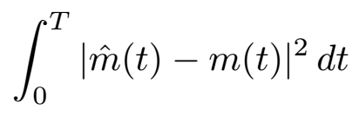

Performance Metrics
Analog communication systems
  Metric is fidelity, closeness to original signal
  We want
  A common measure of infidelity is the Mean Square Error (MSE):
Digital communication systems
  Metrics are data rate R in bits/sec and probability of bit error
  Without noise, never make bit errors
  With noise, P_{e} depends on signal power, noise power, data rate, and
  channel characteristics.

Slide 17


Data Rate Limits
Maximum data rate R is limited by signal power, noise power, distortion
Without distortion or noise, we could transmit at R = ∞ and error
probably P_{e} = 0
The channel capacity (1948, Claude Shannon) is the maximum possible data rate for a system with noise and distortion
  This maximum rate can be approached with bit probability close to 0
  For additive white Gaussian noise (AWGN) channels (no distortion),
  _{notes: B = bandwidth,} _{SNR = voltage ratio}
  This theoretical result does not tell how to design real systems and assumes that you have forever to decide what bit was received. Engineers have spent the last 70 years trying to achieve speed approaching the channel capacity.
Shannon obtained C = 32 Kbps for telephone channels (B=3kHz, SNR~30dB)
Get higher rates with video modems/DSL (They use much more bandwidth)

