Slide 1
Chapter 4
Amplitude Modulation and Demodulation
Part 2

Slide 2
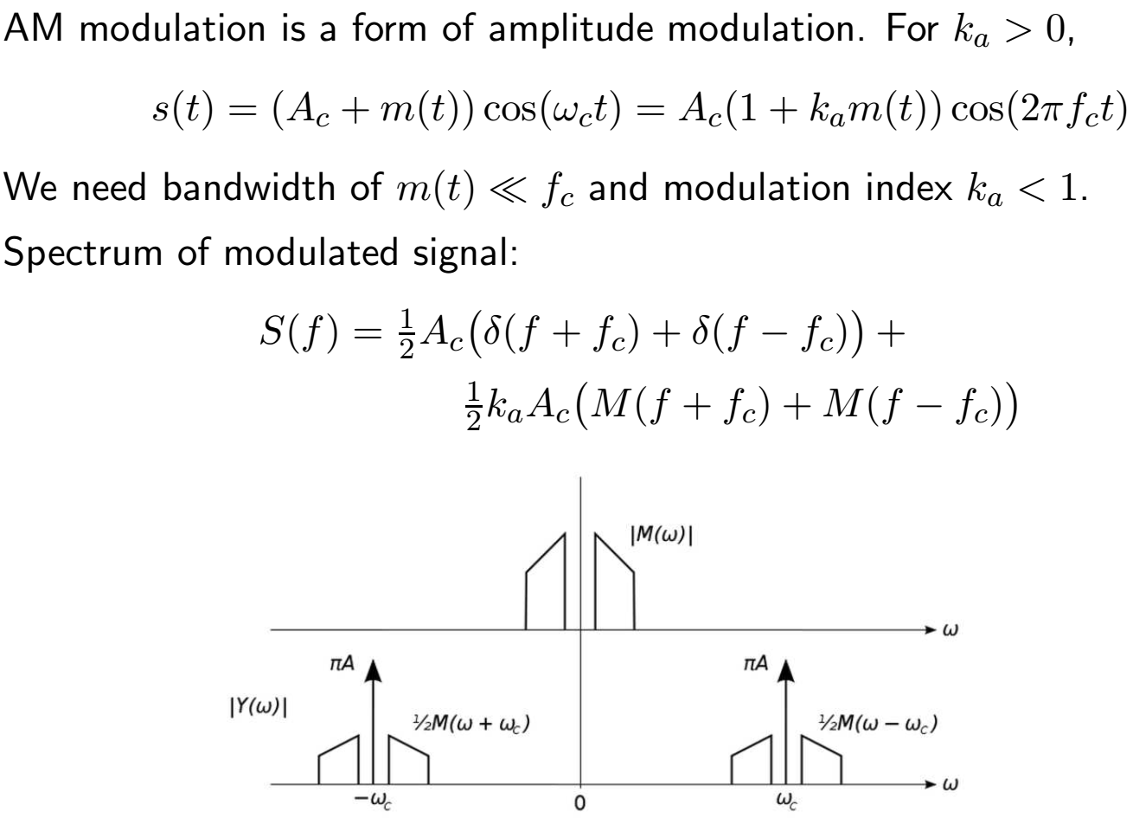
Standard AM Broadcast Modulation – DSB-WC
Notes:
ka < 1 so that a simple “envelope detector” can demodulate the received signal.

Slide 3
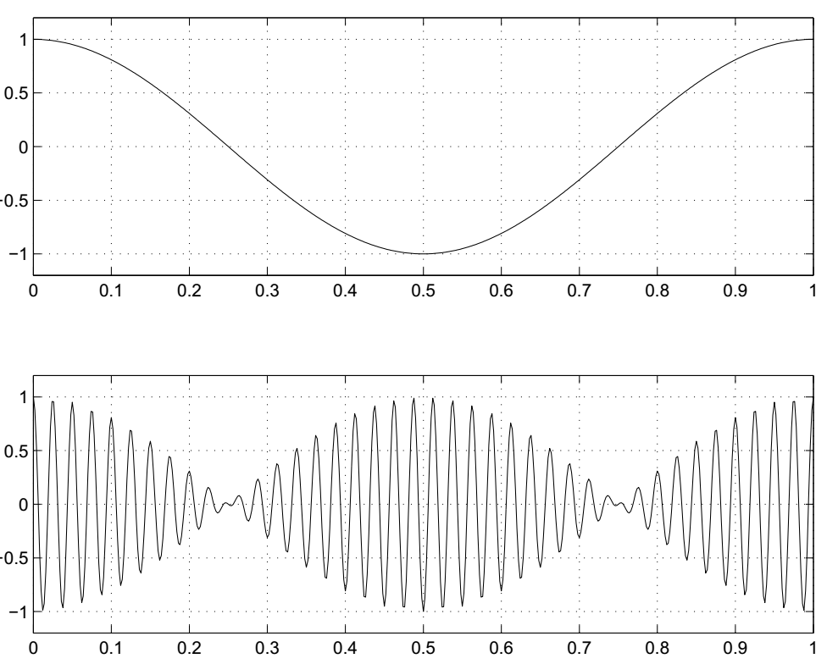
DSB-SC vs. AM
DSB-SC modulated signals undergo phase reversal when m(t) changes sign. It is difficult to extract carrier from received signal.

Slide 4
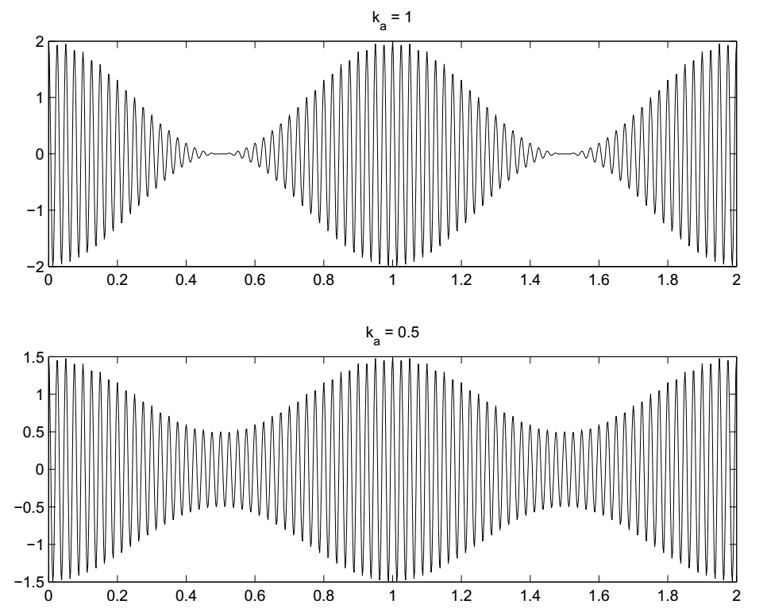
DSB-SC vs. AM (cont.)
In AM, the carrier signal is modulated and the carrier is added to produce
A[1 + k_{a}m(t)]c(t). Examples: k_{a} = 1 (100% modulation) and k_{a} = 0.5 (50% modulation)
Phasors again
Now we add some carrier to DSB-SC
k_{a}m(t)cos(ω_{c}t)
A cos(ω_{c}t)
And get a phasor with a length that varies with m(t) as in the time domain pictures on the right.
Notes:
Again k_{a}m(t) varies slowly compared to ω_{c} and it has no DC value. It’s peak values are less than A or over modulation occurs.

Slide 5
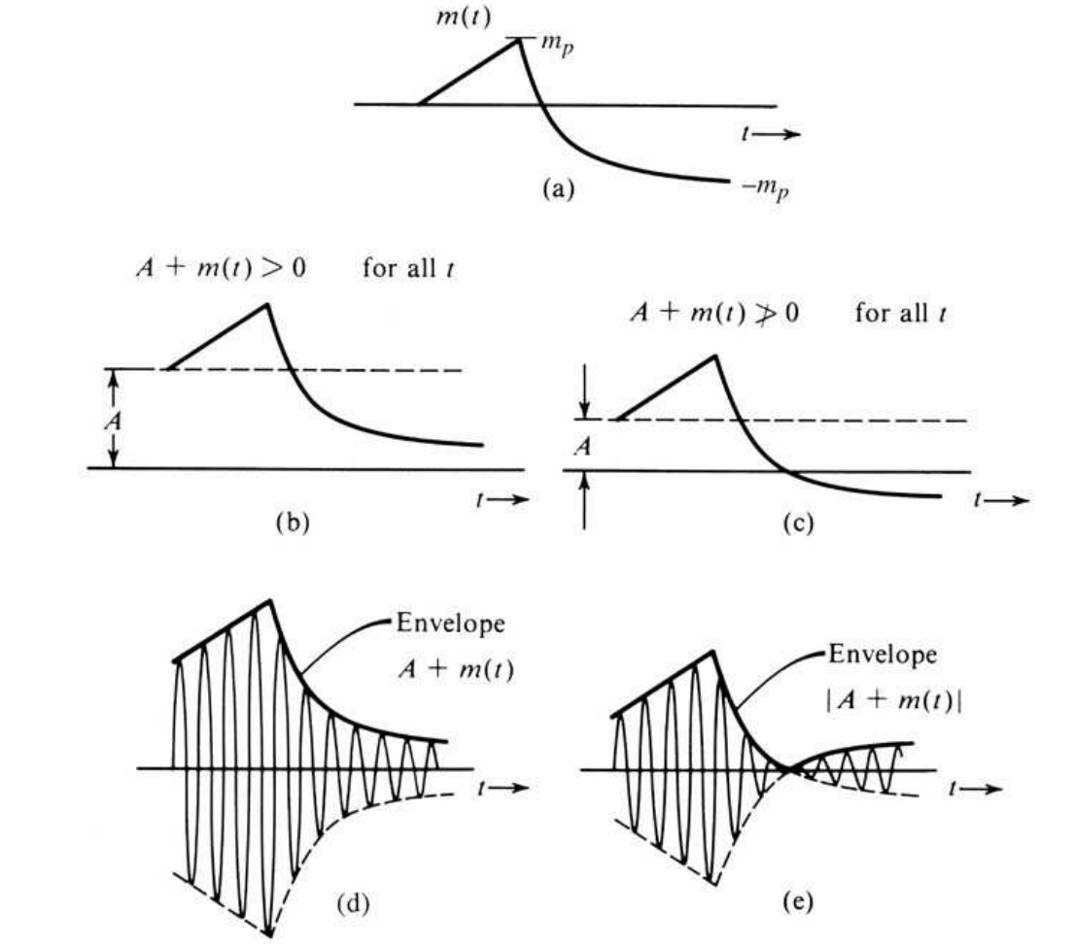
AM Signal and Its Envelope
Notes:
“e” is “over modulated” AM

Slide 6
Envelope Detection of AM Signals
The term detection means extracting signal from received data. In most cases it means demodulation.
Suppose that a signal x(t) can be written as
x(t) = E(t)cos ωct ,
where E(t) varies slowly compared to the carrier cos ωct.
Then |E(t)| is called the envelope of x(t).
For envelope detection to work, we need
fc ≫ bandwidth of m(t)
Otherwise positive and negative spectral components overlap. And
A + m(t) ≥ 0
Otherwise phase reversals occur when A + m(t) < 0.

Slide 7
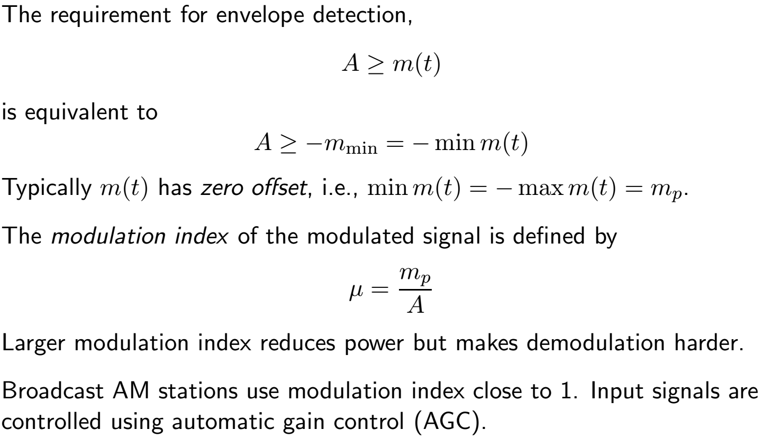
Message Signal Peak and Offset
Notes:
Zero offset is not the same as zero DC value.

Slide 8
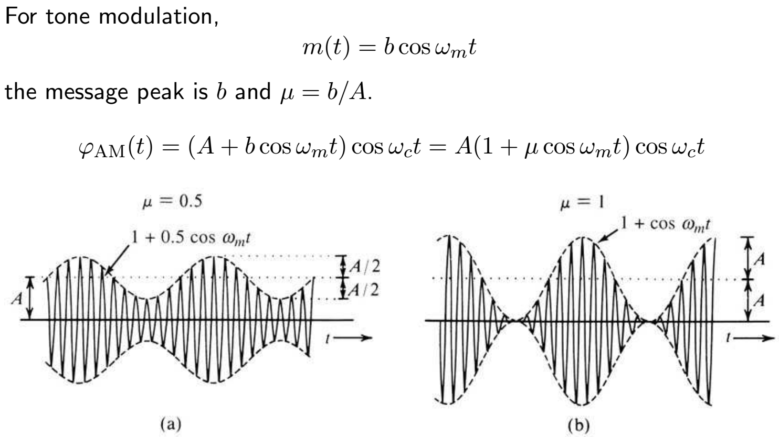
Modulation Index Example

Slide 9
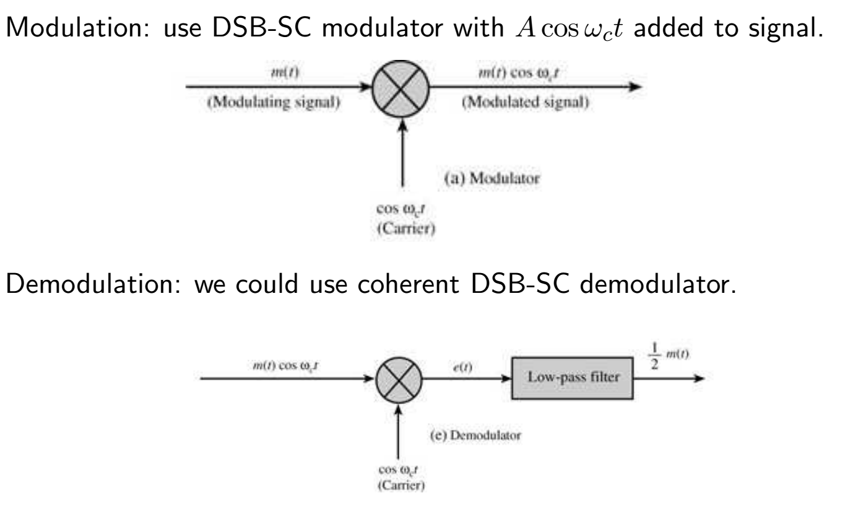
Modulation and Demodulation of AM Signals
Notes:
This approach fails to use the carrier component except as a reference for synchronization, usually via a Phase-Locked-Loop (PLL).
It does, however perform better in the presence of noise (about 3dB improvement in S/N).

Slide 10
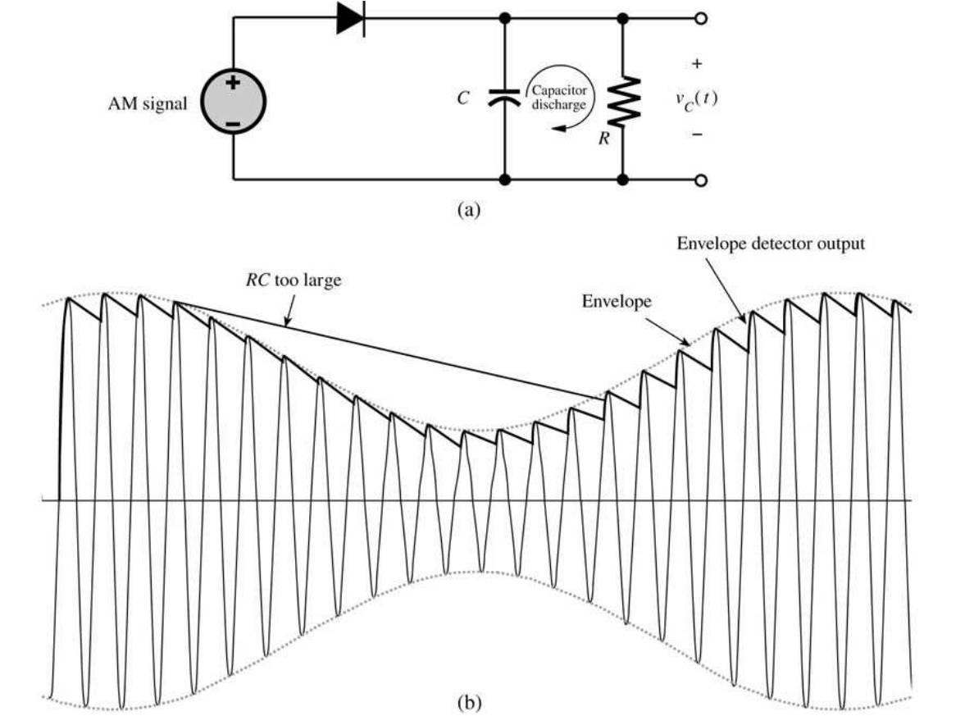
Envelope Detector for AM
Notes:
This works well as long as <100% modulation and a carrier frequency >> than the highest modulating frequency.

Slide 11
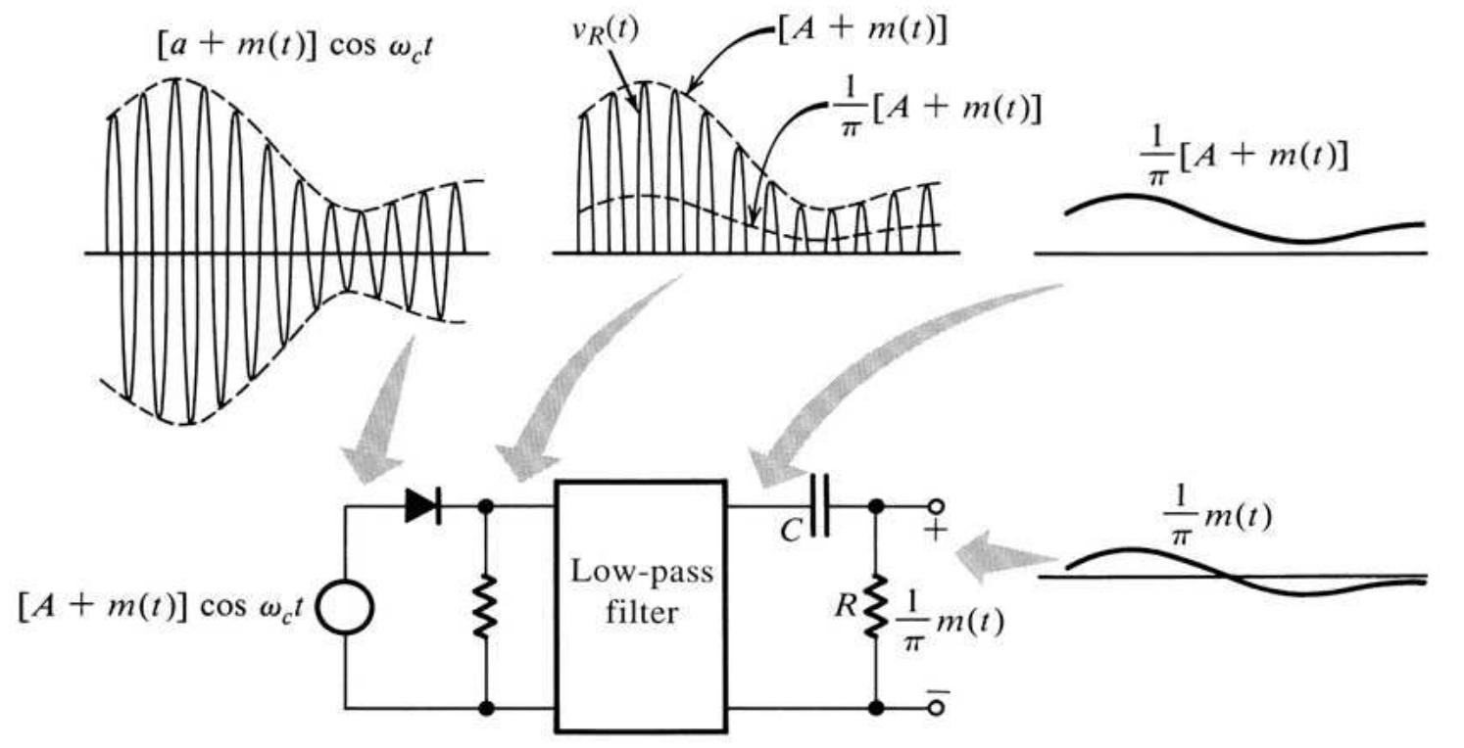
AM Demodulation: Rectifier + Low pass Filter
Notes:
Diodes were the first semiconductor electronic devices. The discovery of crystals’ rectifying abilities was made by German physicist
Ferdinand Braun in 1874. The first semiconductor diodes, called cat’s whisker diodes, developed around 1906, were made of
mineral crystals such as galena. Today most diodes are made of silicon, but other semiconductors are sometimes used.

Slide 12
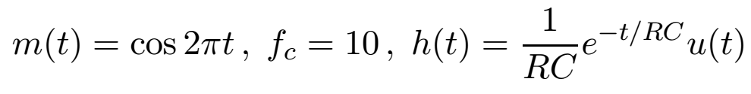
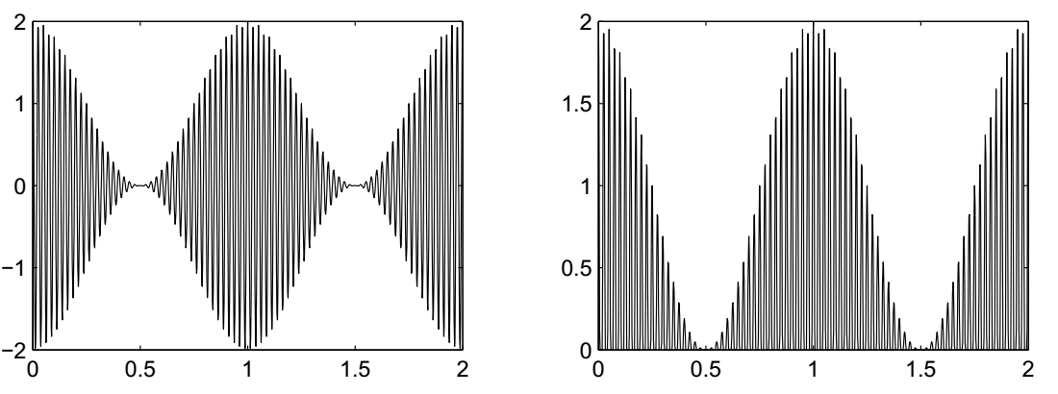
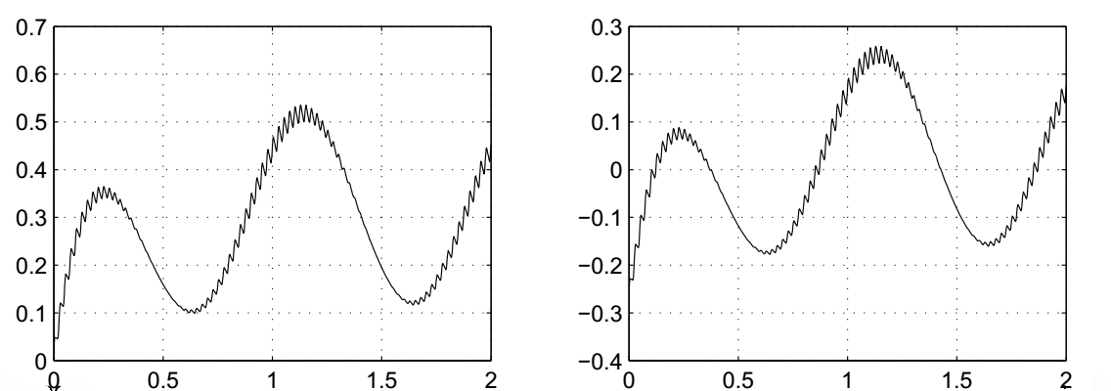
AM Demodulation Experiment

Slide 13
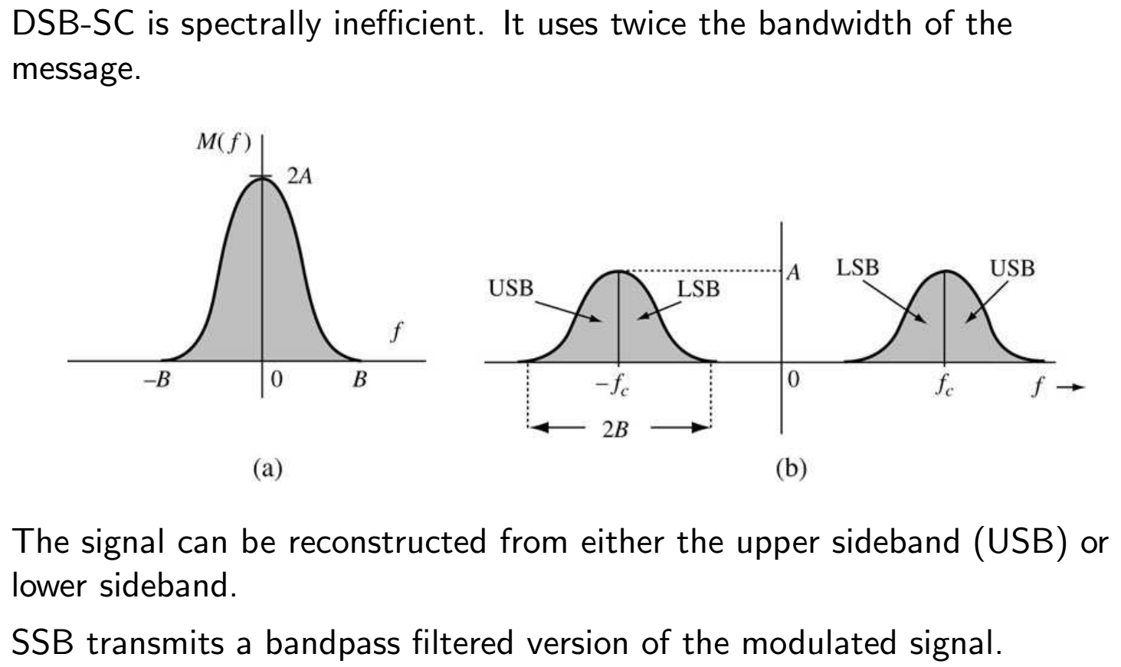
Single Sideband (SSB)
Notes:
Filtered should be in quotes since that is not usually the way it is done.

Slide 14
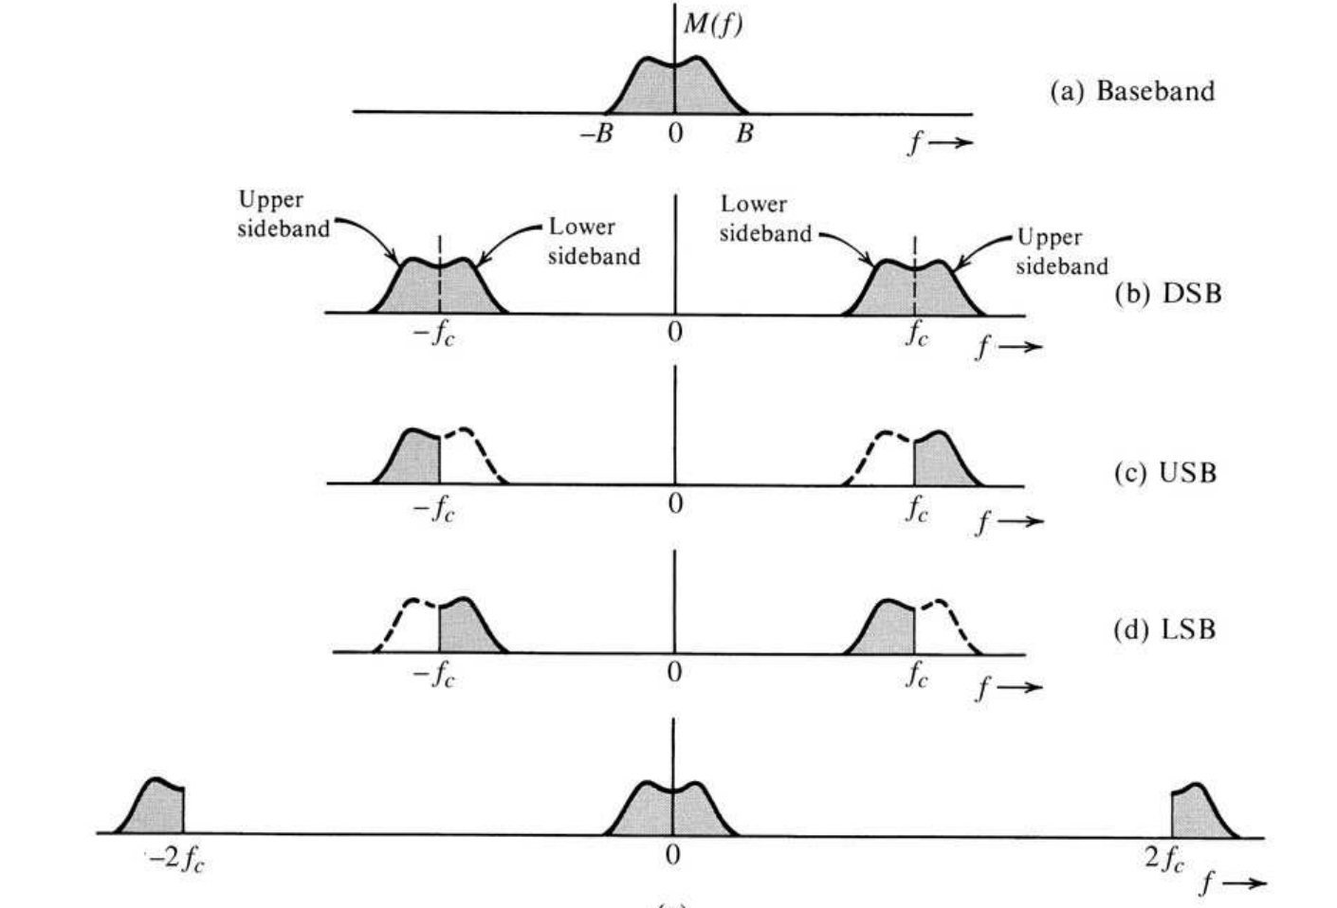
Single Sideband (cont.)

Slide 15
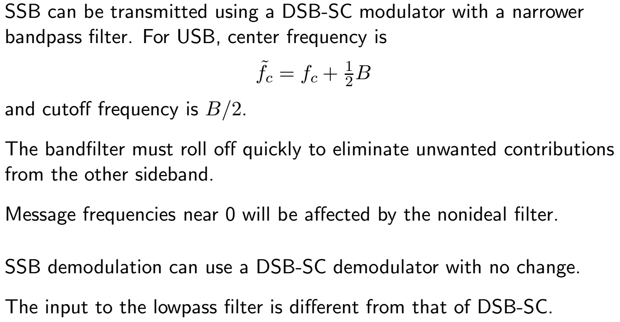
Single Sideband Modulation and Demodulation
Notes:
SSB is often generated using phase inversion to cancel one of the sidebands. A more technically sophisticated approach that eliminates the need for a sharp cutoff filter.

Slide 16
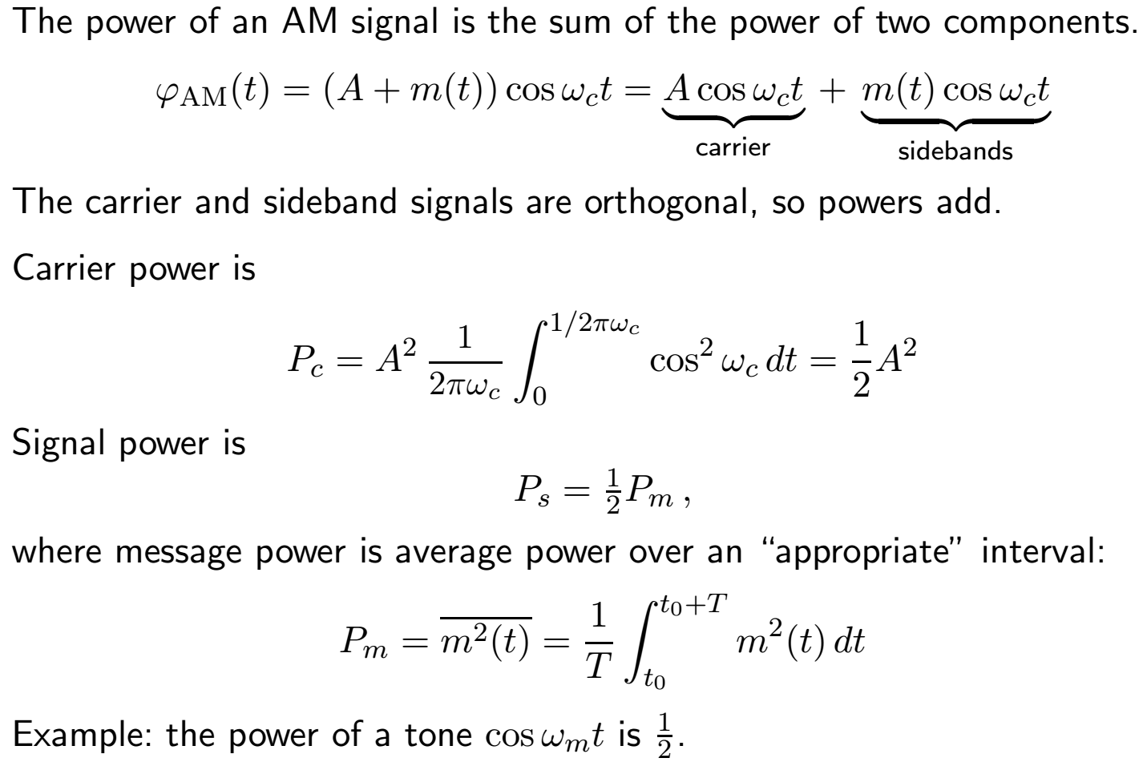
Power in AM Signals

Slide 17
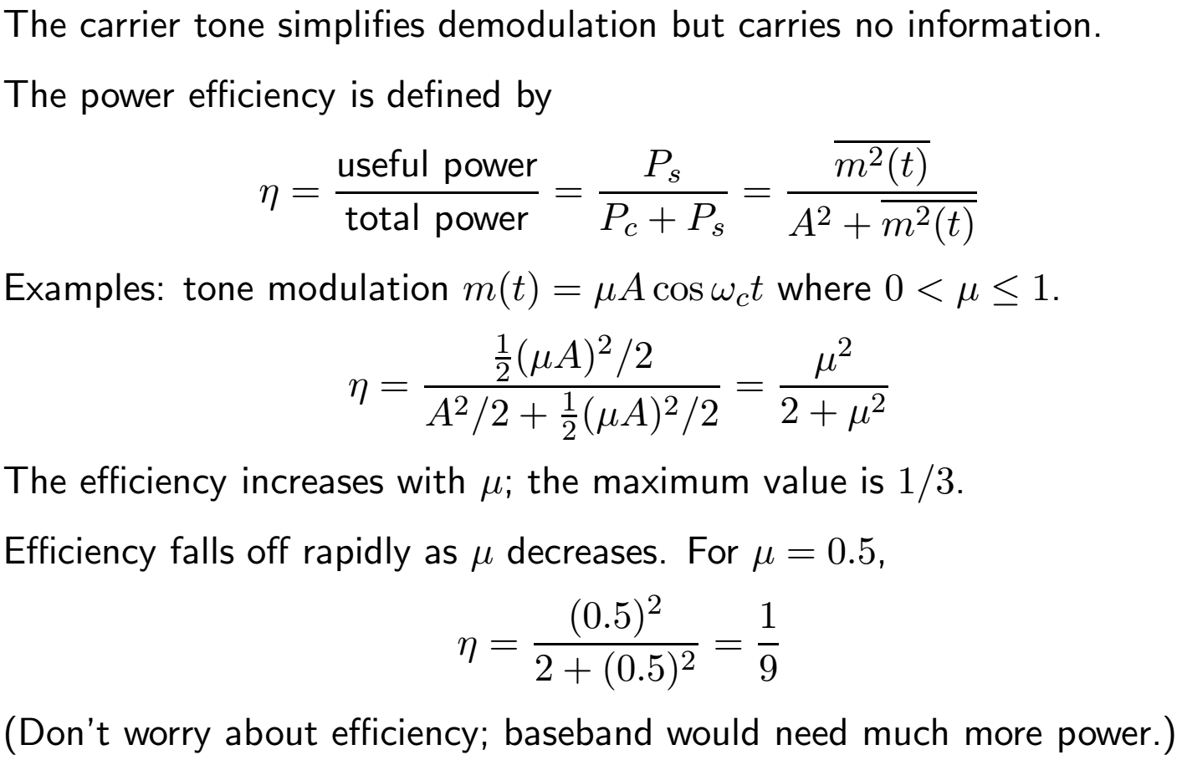
Power of AM Signals 2

Slide 18
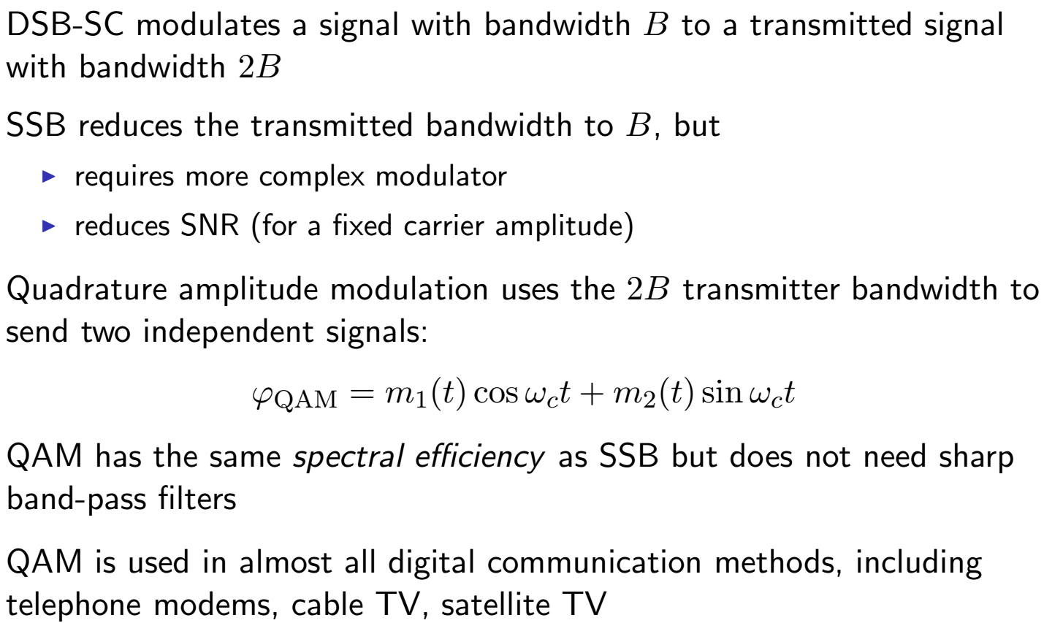
Quadrature Amplitude Modulation (QAM)

Slide 19
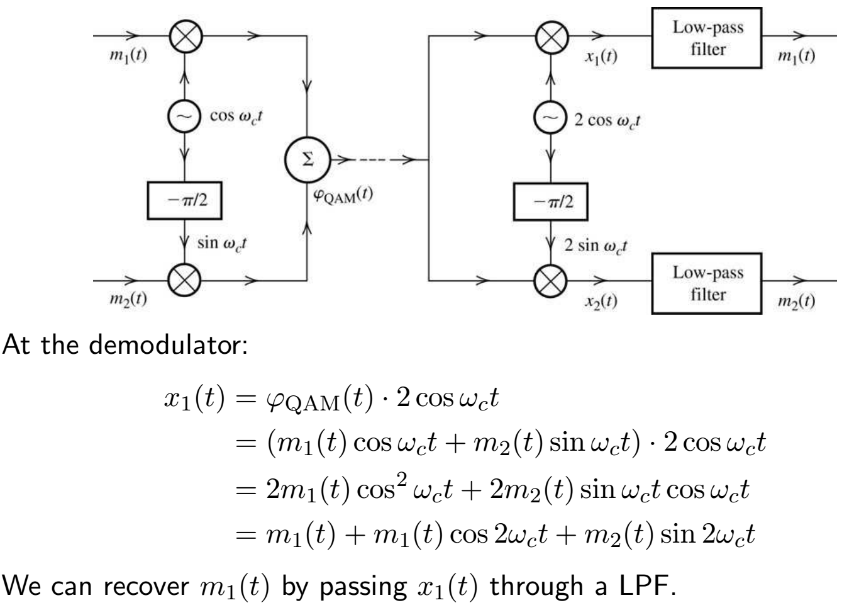
QAM Modulator and Demodulator

Slide 20
Noise in AM Systems
There is always noise
  External (channel) sources
  Receiver self generated noise
We normally assume a White, Gaussian noise (exception is Impulse Noise)
Only the noise that lies in the signal bandwidth needs to be considered since the receiver filters out all other noise.
Noise has random phase and amplitude so two equal components
  In phase with the carrier
  90° out of phase
Asynchronous detection (e.g. envelope detector) sees both components
Synchronous detectors only see one component at a time:
3dB better S/N (noise power cut in half)

