Slide 1
Chapter 7e
Digital Receivers
Notes:
Taken from “Digital Communications Fundamentals and Applications”, Bernard Sklar, Edition 2, Prentice Hall PTR, 2001, ISBN 0-13-084788-7

Slide 2
Today we are going to talk about:
Receiver structure
Demodulation (and sampling)‏
Detection
First step for designing the receiver
Matched filter receiver
Correlator receiver
Detection:
Estimate the transmitted symbol based on the received sample

Slide 3
Demodulation and detection
Format
Pulse
modulate
Bandpass
modulate
M-ary modulation
channel
transmitted symbol
Major sources of errors:
Thermal noise (AWGN)‏
disturbs the signal in an additive fashion (Additive)
has flat spectral density for all frequencies of interest (White)‏
is modeled by Gaussian random process (Gaussian Noise)
Inter-Symbol Interference (ISI)‏
Due to the filtering effect of transmitter, channel and receiver, symbols are “smeared”.
estimated symbol
Format
Detect
Demod.
& sample

Slide 4
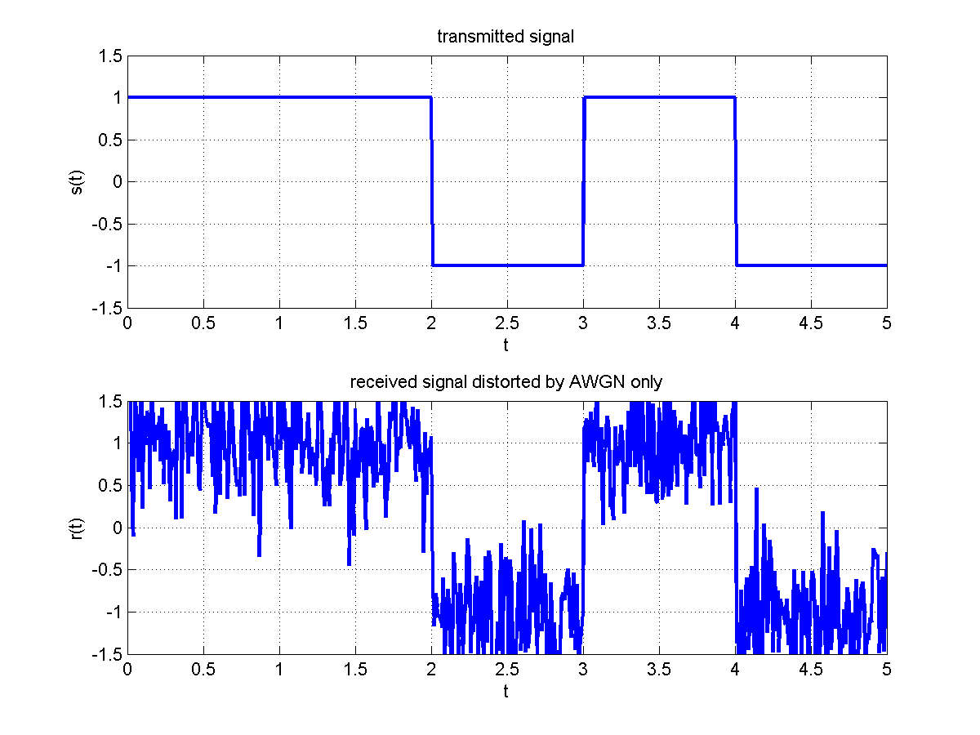
Example: Impact of the channel

Slide 5
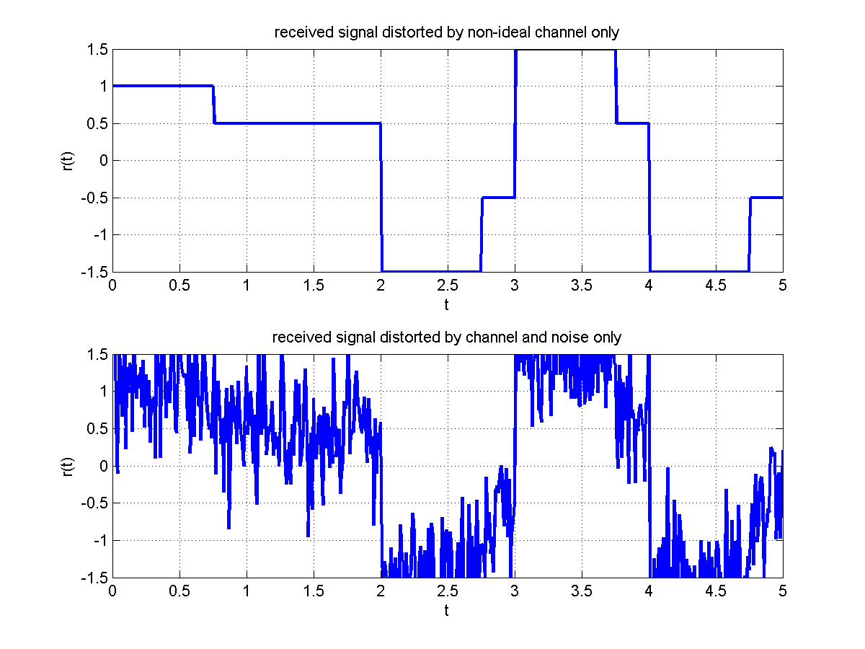
Example: Channel impact …

Slide 6
Receiver tasks
Demodulation and sampling:
Waveform recovery and preparing the received signal for detection:
Improving the signal power to the noise power (SNR) using matched filter
Reducing ISI using equalizer
Sampling the recovered waveform
Detection:
Estimate the transmitted symbol based on the received sample

Slide 7
Correlator receiver
The matched filter output at the sampling time, can be realized as the correlator output.
Notes:
A “Matched Filter” has an impulse response which is a reversed copy of the transmitted pulse shape. It effectively “correlates” the received pulse with the original pulse shape to determine if that pulse was sent.

Slide 8

Convolution (Review)
$$z\left(t\right)=\int_{−∞}^{∞}{p\left(τ\right)∗h\left(t−τ\right)dτ}$$
Notes:
Peak area of the product is at the end of the pulse time.

Slide 9
Implementation of matched filter receiver
Bank of M matched filters
Matched filter output:
Observation
vector
Notes:
The “correlator” output at the end of the symbol time is a maximum if the two shapes are the same.

Slide 10
Implementation of correlator receiver
Bank of M correlators
Correlators output:
Observation
vector

Slide 11
Implementation example of matched filter receivers
Bank of 2 matched filters
0
T
t
0
T
0
T
0
T
t

Slide 12
Implementation of the matched filter receiver
Bank of N matched filters
Observation
vector

Slide 13
Implementation of the correlator receiver
Bank of N correlators
Observation
vector

Slide 14
Example of matched filter receivers using basic functions
0
T
t
0
T
t
0
T
t
1 matched filter
0
T
t
Number of matched filters (or correlators) is reduced by 1 compared to using matched filters (correlators) to the transmitted signal.
Reduced number of filters (or correlators)‏

Slide 15
White noise in the orthonormal signal space
AWGN, n(t), can be expressed as
Noise projected on the signal space
which impacts the detection process.
Noise outside of the signal space
Vector representation of
independent zero-mean Gaussain random variables with variance

